Slide 1

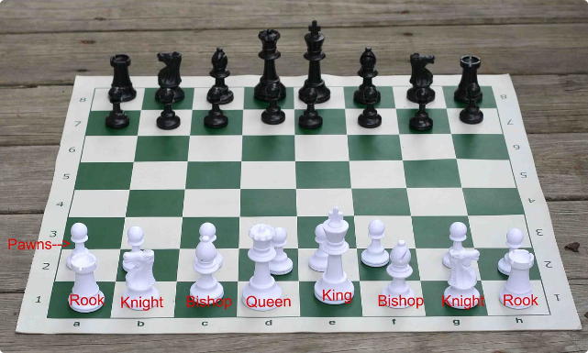

N-Queens Visualizer
The N-Queens problem is a classic puzzle in computer science. The goal is to place N chess queens on an N×N chessboard so that no two queens threaten each other.
by Sumant Yadav

Slide 2

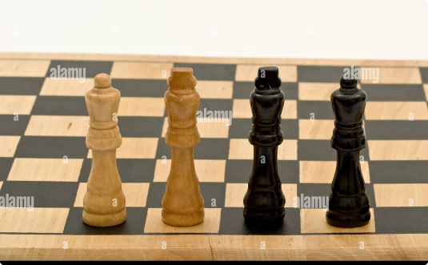
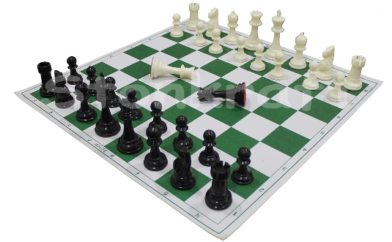
Visualizing the N-Queens Problem
Single Queen
Two Queens
Multiple Queens
The starting point is a chessboard with a single queen placed in any square.
The challenge is to place a second queen without it being under attack by the first queen.
As we add more queens, the complexity of finding valid placements increases.

Slide 3

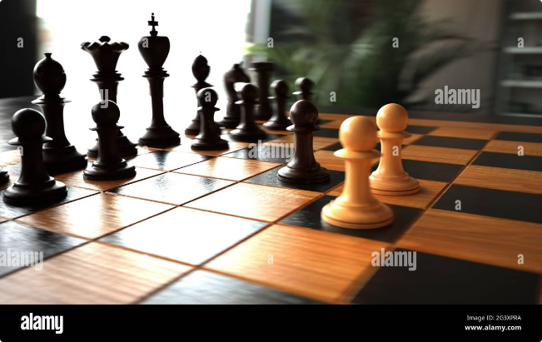
Algorithms for Solving the N-Queens Problem
1
Backtracking
2
Brute Force
A systematic approach that explores possible placements one step at a time. It backtracks if a queen is placed in an invalid position.
Examines all possible queen placements on the board. It can be computationally expensive for larger boards.
3
Constraint Satisfaction
4
Heuristic Algorithms
Employ strategies to quickly identify promising solutions, often used for large N-Queens problems.
Defines constraints on queen placements, using techniques like variable assignment and constraint propagation.

Slide 4
Backtracking Algorithm
Initialization
1
Start with an empty chessboard.
2
Place Queen
Place a queen in the first row.
Check Validity
3
Check if the queen's position is valid (not under attack).
4
Advance Row
Move to the next row and place a queen.
Backtrack
5
If an invalid position is found, backtrack to the previous row and try a different placement.
6
Solution
Continue placing queens until a solution is found, or all possibilities are explored.

Slide 5


Brute Force Approach
Approach
Description
Generate All Placements
Create all possible arrangements of queens on the board.
Check Validity
Check if each placement is valid (no queens under attack).
Count Valid Solutions
Count the number of valid placements that satisfy the N-Queens problem.

Slide 6

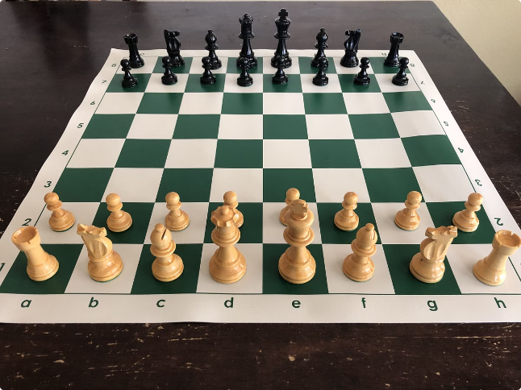
Constraint Satisfaction Techniques
Constraints
Variable Assignment
Formulate constraints to ensure that no two queens are on the same row, column, or diagonal.
Assign queens to different squares on the board.
Constraint Propagation
Search Strategies
Employ backtracking and other search techniques to find solutions while satisfying constraints.
Propagate the effects of each queen placement to eliminate invalid squares for future queens.

Slide 7





Visualization Features
Interactive Board
A visual representation of the chessboard, allowing users to interact with the queens.
Queen Placement
The ability to place queens on the board and visualize their positions.
Attack Lines
Highlighting the attack lines of each queen to visualize threats and constraints.
Solution Display
The capability to display solutions to the N-Queens problem.
Step-by-Step Animation
Visualizing the algorithm's steps, such as backtracking or constraint propagation.

Slide 8

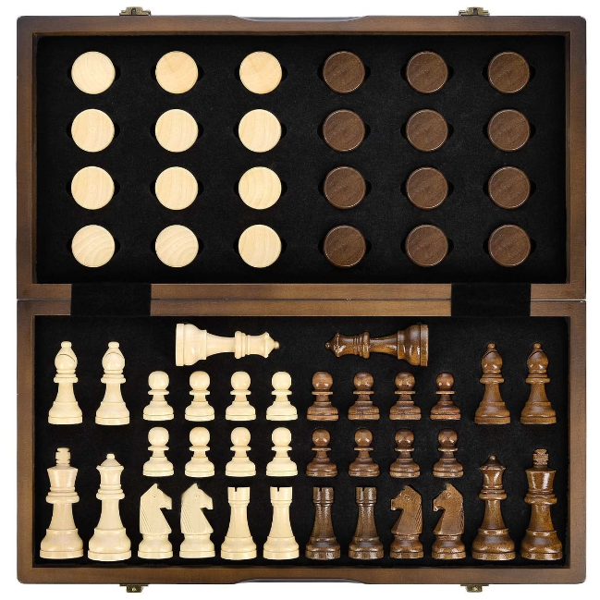




User Interface Design
Intuitive Design
Customization Options
A user-friendly interface that is easy to navigate and understand.
Allow users to customize the appearance of the chessboard, queen colors, and animation speed.
Algorithm Selection
Help and Documentation
The option to choose different algorithms to solve the N-Queens problem.
Providing clear explanations and documentation on the N-Queens problem and the algorithms used.

Slide 9
Challenges and Limitations
Computational Complexity
Visualization Performance
User Experience
Balancing interactive features with performance to ensure a smooth and responsive user experience.
The N-Queens problem is NP-complete, meaning the time complexity grows exponentially with the size of the board.
Visualizing large N-Queens problems can be computationally demanding, requiring efficient algorithms and optimizations.

Slide 10


Conclusion and Future Enhancements
The N-Queens Visualizer offers a compelling way to explore and understand this classic problem. Future enhancements could include advanced algorithms, improved visualization techniques, and interactive features that encourage user engagement.

